Slide 1
6 ANNOTATIONS TYPES
WHATS THE DIFFERENCE

Slide 2
6 Types of Annotation
BPP3DSL
BOUNDING : framed rectangular box around target object, automotive , security and e-Commerce
POLYGON : irregular shapes, human bodies, logos, street lights
POLYLINE : used for lanes and road images, reducing extra space
3D Cuboids: measure volumes of vehicles, building or furniture
SEGMENTATION : layers of alike objects labeled until every pixel of picture is done, complicated than polygons, gives better detection.
LANDMARK : facial & emotional, density of target object in specific scene

Slide 3
Data and Annotation Tools
driving automative cars annotation ideas – Search
Object & Environments : Bounding Boxes/Polygons, Semantic Segmentation, Instance Segmentation
Lane and Road Feature marking:
Traffic and Behaviour Cues
Weather and Lighting
Event and Risk Detection

Slide 4
Object & Environment Detection
Bounding Boxes / Polygons for vehicles, pedestrians, cyclists, animals.
Semantic Segmentation for roads, sidewalks, lane markings, traffic signs, and vegetation.
Instance Segmentation to differentiate between multiple objects of the same class (e.g., two cars side-by-side).

Slide 5
2. Lane & Road Feature Marking
Lane Line Annotation (solid, dashed, double, yellow, white).
Drivable Area Segmentation to distinguish safe vs. unsafe zones.
Curb & Road Edge Detection for navigation in urban and rural settings.
3. Traffic & Behavior Cues
Traffic Light State Annotation (red, yellow, green, blinking).
Sign Recognition (speed limits, stop, yield, pedestrian crossing).
Behavior Tagging (vehicle turning, overtaking, braking, merging).

Slide 6
4. Weather & Lighting Conditions
Tagging frames with environmental context (rain, fog, snow, night, glare).
Annotating visibility levels for AI adaptation in low-visibility scenarios.
5. Event & Risk Detection
Accident / Hazard Marking (fallen objects, potholes, roadblocks).
Near-Miss Situations for predictive safety models.
Emergency Vehicle Detection for priority response.

Slide 7
driving automative cars annotation ideas – Search
driving automobile cars annotation ideas - Search

Slide 8
🚗 Driving & Automobile Annotation Ideas
1. Object Detection & Classification
Vehicles by type (car, truck, bus, motorcycle, bicycle)
Pedestrians, animals, road debris
Emergency vehicles with flashing lights
2. Lane & Road Marking Segmentation
Lane boundaries (solid, dashed, double)
Crosswalks, stop lines, arrows
Temporary construction markings

Slide 9
3/ Traffic Sign & Signal Recognition
Sign type (speed limit, stop, yield, warning)
Traffic light states (red, yellow, green)
Digital signboards with changing messages
4. Driver Behavior & Cabin Monitoring (for in-cabin AI)
Eye gaze tracking (alertness detection)
Hand position on steering wheel
Seatbelt usage

Slide 10
5 Weather & Lighting Conditions
Rain, fog, snow, glare, night driving
Wet vs. dry road surface annotation
6 Hazard & Event Tagging
Sudden braking events
Road accidents or near-misses
Obstructions (fallen tree, pothole)

Slide 11
7. 3D Bounding Boxes & Depth Estimation
For LiDAR or stereo camera datasets
Annotating distance to objects for collision avoidance
8. Semantic Scene Understanding
.Urban vs. rural vs. highway environments
Parking lots vs. moving traffic
Construction zones

Slide 12
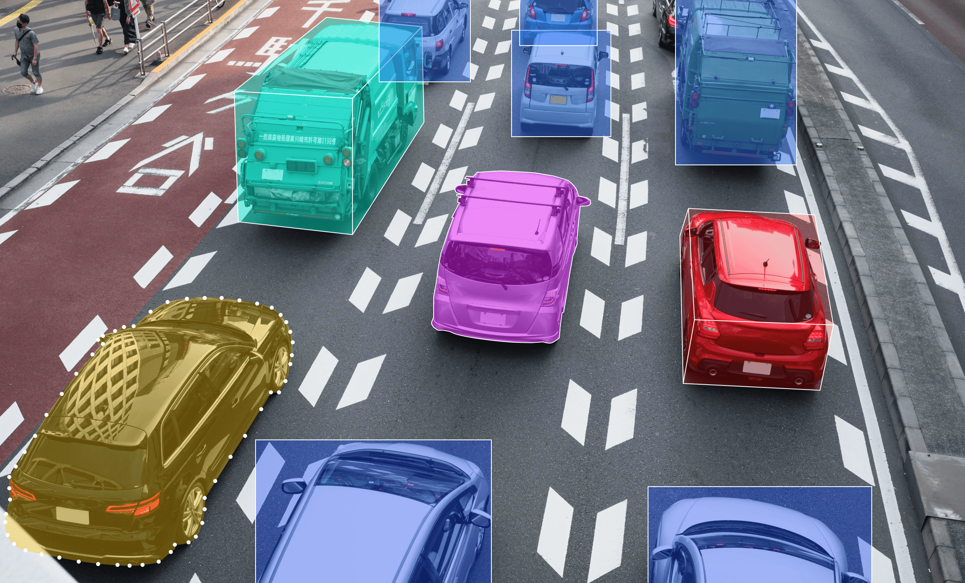
driving automobile cars annotation ideas - Search

Slide 13
driving automobile cars annotation ideas - Search
Automatic Vehicle Classification for Toll Efficiency | Arya Omnitalk

Slide 14
what drives the annotations for safe manouvering of autonomous vehicles?
For autonomous vehicles, annotations are the backbone of safe maneuvering because they provide the labeled training data that machine learning models rely on. Here’s what drives them:
🚗 Core Annotation Types
Bounding Boxes: Mark the position of cars, pedestrians, traffic lights, and other objects.
Segmentation: Pixel-level labeling to distinguish lanes, sidewalks, and drivable areas.
Polygons & Keypoints: Capture irregular shapes (like road signs) or specific features (like joints of pedestrians).
Video Annotation: Tracks moving objects frame by frame to teach the system about motion and trajectory.

Slide 15
Why They Matter
Object Detection: Helps the vehicle recognize and classify obstacles.
Lane Detection: Guides the car to stay within safe boundaries.
Trajectory Prediction: Annotated sequences allow the AI to anticipate how other vehicles or pedestrians will move.
Context Awareness: Differentiates between static objects (like parked cars) and dynamic ones (like cyclists).
⚙️ Driving Factors
Accuracy of Labels: Poor annotation leads to unsafe decisions.
Consistency Across Datasets: Ensures the model generalizes well in varied environments.
Real-Time Relevance: Video annotations help the car adapt to dynamic traffic conditions.
Sensor Fusion: Annotations integrate data from cameras, LiDAR, and radar for a complete picture.

Slide 16
In short, annotations are what translate raw sensor data into meaningful signals the AI can act on. Without them, the vehicle wouldn’t know how to distinguish a pedestrian from a shadow or a lane line from a crack in the road.

Slide 17
Are the machine learning systems for autonomous cars created for all types and makes of cars , larger vehicles and other types?
Autonomous vehicle machine learning systems are not built separately for each car make or model — instead, they’re designed to be general frameworks that can be adapted across different types of vehicles. Here’s how it works:
Core Design
Universal Algorithms: The perception, planning, and control models (object detection, lane keeping, trajectory prediction) are built to work with sensor data, not tied to a specific car brand.
Sensor Inputs: Cameras, LiDAR, radar, and GPS feed into the same AI pipeline regardless of whether it’s a sedan, SUV, or truck.
Training Data: Annotated datasets include diverse scenarios — urban streets, highways, rural roads — with different vehicle sizes and behaviors.

Slide 18
Machine Learning System Models
🚛 Applicability Across Vehicle Types
Passenger Cars: Most early development focused here, since they’re the largest market.
Larger Vehicles (Trucks, Buses): The same AI principles apply, but models are fine-tuned for longer stopping distances, wider turning radii, and blind spots.
Special Vehicles (Delivery vans, construction equipment): Adaptations are made for unique operating environments (e.g., warehouses, off-road).
🔑 What Changes Between Vehicle Types
Calibration: Each vehicle’s sensors must be aligned and calibrated differently.
Control Systems: The AI’s output (steering angle, braking force) is mapped to the specific vehicle’s hardware.
Safety Margins: Larger vehicles require different safety buffers and maneuvering rules.

Slide 19
machine learning models
Bottom Line
The core machine learning models are general-purpose, but they’re customized and validated per vehicle type to ensure safe maneuvering. Think of it like a universal “brain” that gets tuned to the body it’s placed in.

Slide 20
Illustrate this with a comparison table showing how autonomous AI adapts differently for cars, trucks, and buses?
🚘 Vehicle Type | ⚙️ Sensor Calibration | 🛑 Control & Safety Margins | 🧠 AI Adaptation Focus | 🛣️ Maneuvering Challenges
Passenger Cars | Standard calibration for cameras, LiDAR, radar | Shorter stopping distances, tighter turns | Lane keeping, pedestrian detection, urban driving | Dense traffic, parking, quick lane changes
Trucks | Sensors mounted higher, wider field of view | Longer stopping distances, wider turning radius | Load stability, blind spot monitoring | Highway merging, sharp turns, braking with heavy loads
Buses | Sensors tuned for length and passenger safety | Large safety buffers, smooth braking | Passenger comfort, frequent stops, route adherence | Crowded urban streets, frequent pedestrian crossings, wide turns

Slide 21
Same AI “brain”:
🔑 Key Takeaways
Same AI “brain”: The core perception and planning models are universal.
Different “body tuning”: Each vehicle type requires calibration for its size, dynamics, and operating environment.
Safety-first adaptation: Larger vehicles (trucks, buses) demand more conservative safety margins compared to cars.
So, while the machine learning models are general-purpose, they’re fine-tuned per vehicle type to ensure safe maneuvering in real-world conditions.

Slide 22
what work packages for offloading annotating work are there for freelancers to submit offers?
Freelancers can submit offers for autonomous vehicle annotation projects through platforms like Freelanly, Upwork, and LinkedIn, where work packages typically include video annotation, image labeling, LiDAR point cloud annotation, and QA review tasks. These projects often pay per video, per dataset, or per project tier, depending on complexity.

Slide 23
Common Work Packages for Freelance Annotation
Video Annotation (Driving Footage)
Labeling vehicles, pedestrians, lane markings, intersections, and traffic signs.
Tracking object movement across frames for trajectory prediction.
Example: Quick Annotate offers freelance video annotation tasks with ~36-second clips, paying per video with performance-based bonuses

Slide 24
2. Image Annotation
Bounding boxes for cars, cyclists, and road features.
Semantic segmentation for drivable areas, sidewalks, and obstacles.
Example: Upwork freelancers provide bounding box annotation services for autonomous vehicle datasets, with tiered packages ($50–$100 depending on speed and revisions).
3. LiDAR / 3D Point Cloud Annotation
Annotating 3D sensor data to identify vehicles, pedestrians, and infrastructure.
Used for depth perception and collision avoidance.
Example: Freelanly projects specifically request 2D/3D/LiDAR annotation experts for autonomous driving datasets.

Slide 25
4. ADAS (Advanced Driver Assistance Systems) Annotation
Specialized labeling for lane departure warnings, adaptive cruise control, and intersection scenarios.
Includes tagging vehicle movements and environmental events.
5. QA & Rework Packages
Reviewing annotated datasets for accuracy.
Correcting errors and ensuring consistency across large-scale projects.
Often offered as separate freelance contracts for quality assurance.

Slide 26
Platforms Offering Annotation Work
Freelanly: Direct-to-recruiter projects for autonomous driving annotation, requiring 20+ hours/week commitment.
Upwork: Freelancers list annotation services with fixed-price tiers for bounding box, LiDAR, and segmentation tasks.
LinkedIn (Quick Annotate): Full-time freelance video annotation projects with competitive pay per video and training provided.

Slide 27
Risks & Considerations
Consistency & Accuracy: Annotation errors can compromise safety-critical AI models.
Payment Models: Some platforms pay per video, others per dataset — freelancers should confirm rates before committing.
Scams: Be cautious of projects requiring upfront fees or hidden contact details; legitimate platforms (Upwork, LinkedIn) provide secure payment protection.
Workload: Projects often require repetitive tasks and long hours; freelancers should assess availability before bidding.

Slide 28
step-by-step guide to pitching your freelance services for autonomous vehicle annotation projects
Step-by-Step Guide
1. Research the Platform
Identify where projects are posted (Upwork, LinkedIn, Freelanly, Quick Annotate).
Review job descriptions carefully to understand required annotation types (video, image, LiDAR).
2. Highlight Relevant Skills
Emphasize experience with annotation tools (e.g., CVAT, Labelbox, Supervisely).
Mention familiarity with autonomous driving datasets (traffic signs, pedestrians, lane markings).

Slide 29
3. Showcase Accuracy & Consistency
Stress attention to detail and ability to maintain labeling standards.
If possible, include metrics (e.g., “maintained 98% accuracy across 10,000 frames”).
4. Offer Flexible Packages
Propose clear deliverables: per video, per dataset, or per hour.
Include tiered options (basic bounding boxes, advanced segmentation, QA review).

Slide 30
5. Demonstrate Reliability
Highlight ability to meet deadlines and handle repetitive tasks.
Mention availability (e.g., “20+ hours per week commitment”).
6. Add a Professional Touch
Keep proposals concise, structured, and tailored to the client’s project.
Avoid generic pitches — reference the specific annotation type requested.

Slide 31
Subject: Proposal for Autonomous Vehicle Annotation Project
Subject: Proposal for Autonomous Vehicle Annotation Project
Hello [Client Name],
I am excited to submit my offer for your autonomous vehicle annotation project. With hands-on experience in video and image labeling for AI datasets, I specialize in bounding boxes, semantic segmentation, and LiDAR point cloud annotation.
Key strengths I bring:
- Proficiency with tools such as CVAT and Labelbox
- Proven accuracy (98%+ consistency across large datasets)
- Experience annotating traffic signs, lane markings, pedestrians, and vehicles
- Flexible work packages: per video, per dataset, or hourly
- Availability for 20+ hours per week with fast turnaround

Slide 32
I understand the importance of precision in training autonomous driving models, and I am committed to delivering high-quality annotations that ensure safety and reliability.
I would be happy to discuss your dataset size, preferred annotation format, and timelines to tailor my services to your needs.
Looking forward to collaborating with you.
Best regards,
[Your Name]

Slide 33
“photo + sensor data integration” exercise
Step 1: Choose a Car Image
Start with a simple photo of a car (you can download a royalty-free image from sites like Unsplash or Pexels).
Place it on a road background — this simulates the environment.
Step 2: Add a “Virtual Sensor”
Instead of a real sensor, you can annotate the image with bounding boxes or labels.
Example: Draw a box around the car and label it as “Vehicle.”
Add a line in front of the car labeled “Distance Sensor Range” to simulate LiDAR or radar.

Slide 34
Step 3: Simulate Sensor Data
Create a small table of mock sensor readings (these are not real internet feeds, but they mimic what sensors would output):
Sensor Type | Example Data
LiDAR | Distance to obstacle: 12.5 m
Radar | Relative speed of object ahead: -5 m/s
Camera | Lane detected: center lane
Ultrasonic | Side clearance: 0.8 m

Slide 35
Step 4: Join Image + Data
Place the car image on the road.
Overlay text labels showing sensor readings (e.g., “Obstacle ahead: 12.5 m”).
This mimics how training datasets combine visual input + sensor metadata.
Step 5: Practice Annotation
Use free tools like CVAT or LabelImg to annotate the car and road.
Export the annotations in JSON or XML format — this is how real datasets are structured.

Slide 36
PRACTICE
First place a image of a car on a road
If you’re working with an image editor (like Photoshop, GIMP, or Paint)
Open the image with the car on the road.
Select the rectangle tool (or shape tool).
Draw a box around the car — make sure it tightly fits the outline.
Change the box color (e.g., red or green) so it stands out.
Save the image — this is your first bounding box annotation.

Slide 37
If you’re using an annotation tool (like CVAT, LabelImg, or Supervisely)
Upload your car-on-road image into the tool.
Select “Create Bounding Box” from the toolbar.
Click and drag around the car to form the box.
Assign a label (e.g., “Car”).
Export the annotation (usually in XML, JSON, or COCO format).

Slide 38
What This Represents
The box tells the AI: “This region of the image contains a car.”
Later, you’ll add more boxes for other objects (pedestrians, signs, lanes).
This is how datasets are built for autonomous driving — each object is marked so the AI learns to recognize it.
For your first exercise, I recommend starting with LabelImg (a free, beginner-friendly tool). It lets you draw boxes easily and saves them in a format used by machine learning models.

